Slide 1
Salesforce Connect Custom Apex Adapters for Heroku Redis
Luciano Straga
Salesforce Certified Professional
lucianostraga@icloud.com
@stragaluciano

Slide 2
Forward-Looking Statements
Statement under the Private Securities Litigation Reform Act of 1995:
This presentation may contain forward-looking statements that involve risks, uncertainties, and assumptions. If any such uncertainties materialize or if any of the assumptions proves incorrect, the results of salesforce.com, inc. could differ materially from the results expressed or implied by the forward-looking statements we make. All statements other than statements of historical fact could be deemed forward-looking, including any projections of product or service availability, subscriber growth, earnings, revenues, or other financial items and any statements regarding strategies or plans of management for future operations, statements of belief, any statements concerning new, planned, or upgraded services or technology developments and customer contracts or use of our services.
The risks and uncertainties referred to above include – but are not limited to – risks associated with developing and delivering new functionality for our service, new products and services, our new business model, our past operating losses, possible fluctuations in our operating results and rate of growth, interruptions or delays in our Web hosting, breach of our security measures, the outcome of any litigation, risks associated with completed and any possible mergers and acquisitions, the immature market in which we operate, our relatively limited operating history, our ability to expand, retain, and motivate our employees and manage our growth, new releases of our service and successful customer deployment, our limited history reselling non-salesforce.com products, and utilization and selling to larger enterprise customers. Further information on potential factors that could affect the financial results of salesforce.com, inc. is included in our annual report on Form 10-K for the most recent fiscal year and in our quarterly report on Form 10-Q for the most recent fiscal quarter. These documents and others containing important disclosures are available on the SEC Filings section of the Investor Information section of our Web site.
Any unreleased services or features referenced in this or other presentations, press releases or public statements are not currently available and may not be delivered on time or at all. Customers who purchase our services should make the purchase decisions based upon features that are currently available. Salesforce.com, inc. assumes no obligation and does not intend to update these forward-looking statements.
Notes:
Key Takeaway: We are a publicly traded company. Please make your buying decisions only on the products commercially available from Salesforce.
Talk Track:
Before I begin, just a quick note that when considering future developments, whether by us or with any other solution provider, you should always base your purchasing decisions on what is currently available.

Slide 3
Luciano Straga
Salesforce Certified Professional
Mobile Computing
lucianostraga@icloud.com
@stragaluciano

Slide 4
Session Agenda
Topic Presentation - Scenario Explained Heroku Redis - Redis Databases Capabilities Salesforce Connect – External Sources – External Objects Apex Connector Framework - Demo New Objects Relationships for External Objects - Demo Extra Considerations & Resources Q&A
1
2
3
4
5
6
7

Slide 5
Topic Presentation
Concepts and Use Case Scenario

Slide 6

and keep it INTEGRATED!

Slide 7




Use Case Scenario
Elements Involved
External REST API
Salesforce Connect
Salesforce Org
Web App - Redis DB
Text
Text
Text
Text

Slide 8
Heroku Redis
Redis Database Features & Capabilities

Slide 9


Heroku Redis
Redis Databases
In-memory key-value data storage - NoSQL
Data stored in RAM memory
Flexible Data Types
String
Hashes
Lists -Sets - Sorted Sets
Bitmaps – Hyperloglogs – Geospatial Indexes
Common uses:
Database
Cache (Non long term storage)
Message Broker - Broadcasting

Slide 10
Salesforce Connect
Key Features – External Objects – External Sources

Slide 11

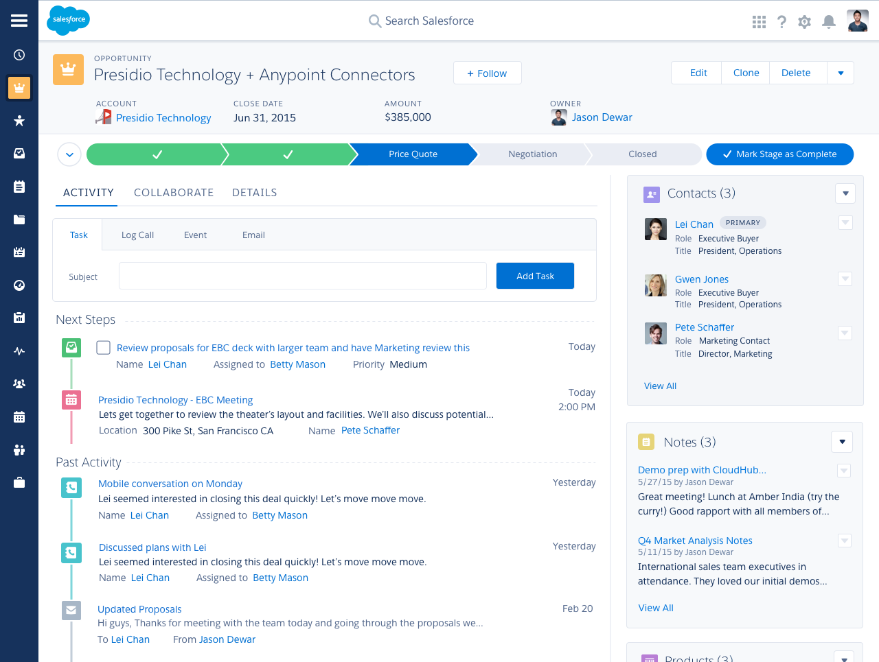

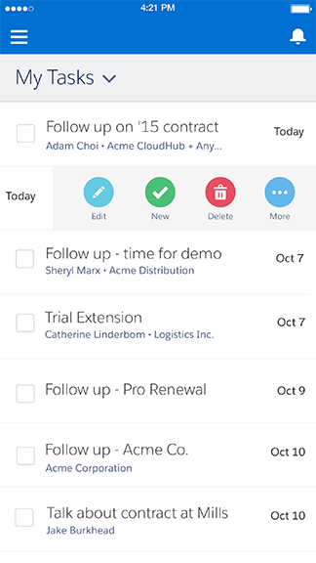
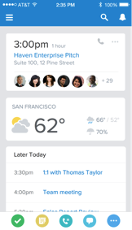
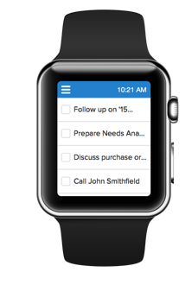
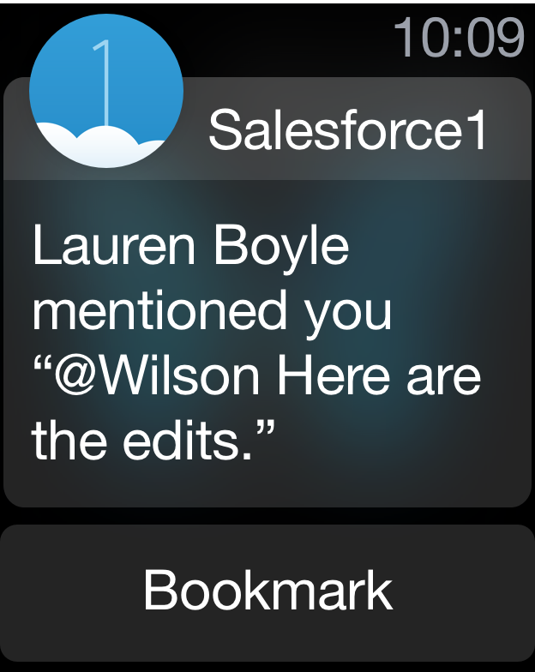


Salesforce Connect
Framework
Seamless integration of external data
CRUD of data stored outside your Salesforce Org.
NO DATA REPLICATION/ Redundancy
Real time data access over external objects.
Always up to date.
Native Adapters – Point & Click Integration
Protocol-specific adapters:
Odata 2.0 / 4.0
Cross-org (Between Salesforce orgs)
Custom Apex Adapters

Slide 12
Salesforce Connect
Used when:
Large amount of data that should not be stored in Salesforce
Small amounts of data at any one time.
Real time access is crucial to get latest data.

Slide 13
Salesforce External Objects
Key Concepts and Features
Similar to custom objects.
__x extension.
Mapped to external data tables in external systems.
New object relationships:
External lookups.
Indirect lookups.

Slide 14
External Objects vs. Custom Objects
Top Differences
Features | Custom Objects | External Objects
Data stored in Salesforce org | Yes | NO
CRUD | Yes | YES*
Tabs / Layouts / Field Level Security | Yes | YES*
REST - SOAP API / SOQL – SOSL / Apex / Visualforce | Yes | YES*
Formulas / Workflow / Triggers / Reports (Winter17!) | Yes | Not yet!
Chatter | Yes | Yes*

Slide 15
Apex Connector Framework
Key Concepts & Capabilities - Demo

Slide 16

Apex Connector Framework
Key Concepts & Capabilities
Set of classes and methods for creating external data sources.
DataSource namespace.
When OData & Cross Salesforce Org adapters are not suitable for the use case.
Based on REST – SOAP callouts.
Own custom adapter implementation.
Two Apex Classes need be extended for creating external data sources:
DataSource.Connection class.
DataSource.Provider class.

Slide 17


Apex Connector Framework
DataSource.Connection class
DataSource.Provider class
Authentication capabilities.
Functional capabilities.
Methods to override:
getAuthenticationCapabilities ().
getCapabilities().
getConnection().
Obtain external system schema and CRUD operations.
Methods to override:
sync().
query().
search().
upsertRows().
deleteRows().

Slide 18
New Object Relationships for External Objects
External & Indirect Lookup Relationships - Demo

Slide 19
New Object Relationships for External Objects
External Lookup Relationships
Indirect Lookup Relationships
External Object
(Parent)
Standard - Custom
(Parent)
Standard - Custom - External
(Childs)
External
(Childs)

Slide 20
Extra Considerations and Resources
To Keep in mind!
Understand the limits of the external system’s API.
Data Type limitation
Double – 18 significant digits. Decimal for better precision.
String - Up to 255 characters. Long text area instead.
Custom Apex adapters are Apex code!
All governor limits apply!
Apex callouts are not allowed after DML.

Slide 21
Extra Considerations and Resources
Apex Connector Framework - Paging & Filtering
Should be implemented in the external service.
Custom adapters don’t automatically support paging (batches).
Server driven (recommended) VS Client driven.
DataSource.TableSelection filter property.
Represents the WHERE clause in a SOQL or SOSL query.
Support for subfilters (AND_, OR_, NOT_).
DataSource.QueryUtils helper methods (local filtering - not recommended).

Slide 22

Session Resources
Blaze your own trail!
https://cloud-airlines.herokuapp.com/
https://github.com/lucianostraga/dreamforce16
https://trailhead.salesforce.com/module/lightning_connect
@stragaLuciano
https://ar.linkedin.com/in/luciano-straga-121a9167

Slide 23
Q&A!
@stragaLuciano

Slide 24
@stragaLuciano

